Slide 1
Gene regulation
- Prokaryote
- Eukaryotes
LIF101 8th April, 2016

Slide 2
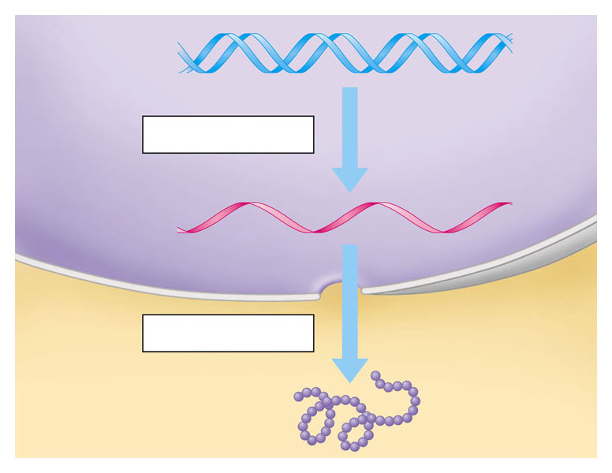
  Flow of genetic information
  A gene is transcribed into RNA
  which is then translated into the polypeptide
DNA
RECAP
Transcription
RNA
Translation
Protein

Slide 3
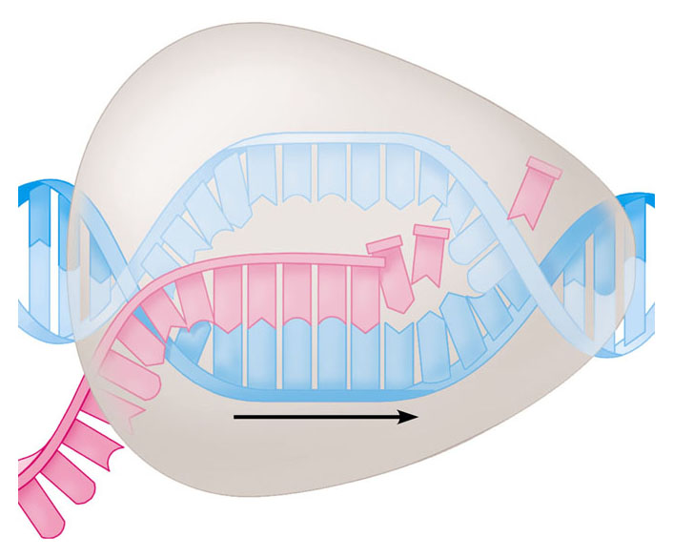
Transcription
RECAP
RNA polymerase
RNA nucleotides
A
T
C
C
A
A
T
C
T
U
T
G
U
G
C
A
U
C
C
A
A
C
C
G
A
A
T
A
G
G
T
T
Direction of transcription
Template Strand of DNA
Newly made RNA

Slide 4
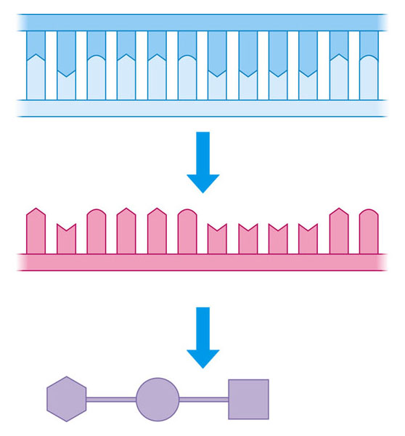
How does DNA/RNA code for protein?
Strand to be transcribed
RECAP
T
A
C
T
T
C
A
A
A
A
T
C
DNA
A
T
G
A
A
G
T
T
T
T
A
G
Codon -
a sequence of nucleotides that codes for an amino acid
Transcription
A
U
G
A
A
G
U
U
U
U
A
G
RNA
Start
condon
Stop
condon
Translation
Polypeptide
Met
Lys
Phe
STEP III TRANSLATION

Slide 5
Gene regulation
But how will RNA polymerase decide which ones to transcribe from hundreds and thousands of genes in our genome??
Regulation of the synthesis of a gene’s transcript and its protein product is termed as gene regulation.

Slide 6
Why control gene expression?
Each of our cells carry entire genetic instructions for our growth, development and metabolic functions.
Some of these genes are needed to be expressed all the time: those regulating our cellular respiration, for instance. These are also called house keeping genes
Other genes are not expressed all the time.
These are switched “on” and “off” on demand

Slide 7
Promoter:
RNA Pol binding site in DNA sequence upstream of transcription start point
A basic scheme
RNA
polymerase
Gene
Direction of transcription
Promoter
Transcriptional Regulation is mediated by controlling the access of the RNA polymerase to the promoter.

Slide 8
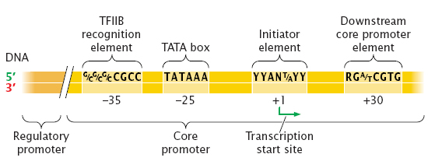
The promoters of genes transcribed by RNA polymerase II consist of a core promoter and a regulatory promoter that contain consensus sequences.
We will not go in to these details either
A point to remember:
Like transcription initiation there are also transcription termination mechanisms

Slide 9
Negative Regulation
Positive Regulation
RNA Polymerase
RNA Polymerase
X
Binding of repressor blocks the binding of the RNA Pol to the promoter
Promoter
An activator help RNA Pol bind to the promoter
Repressor
Activator
X
Recall what is a prokaryote.
Two broad strategies for regulation of prokaryotic transcription

Slide 10
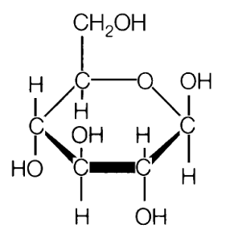
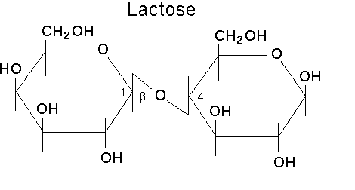
In prokaryotes gene regulation takes place in response to the environment
Glucose
E. coli can use either glucose, which is a monosaccharide, or lactose, which is a disaccharide
However, lactose needs to be hydrolysed (digested) first
So the bacterium prefers to use glucose when it is available.
On the other hand, when only lactose is available it turns “ON” the genes and, therefore, the enzymes required for lactose breakdown
Lactose
Glucose
Galactose

Slide 11
Regulation of the lac Z gene – an example of negative regulation
( lacZ gene codes for β-galactosidase enzyme that breaks down lactose )
What can be the inducer of the lac Z gene?
REPRESSOR
INDUCER
X
INACTIVE REPRESSOR
X
Answer:
lactose
OPERATOR:
Binding site for repressor
When lactose is absent in the medium, the lac Z gene is switched-off . That is, no mRNA is transcribed and no proteins are made.
-In the presence of lactose in the medium, lac Z gene is turned on. That is, mRNA is transcribed and the proteins are made.

Slide 12
Question:1
Repressor is a protein: should there be a separate gene for repressor?
Illustration of a NEGATIVE REGULATION gene expression
INDUCIBLE TRANSCRIPTION
Regulation of lac Z gene
This is also called an inducible model of gene regulation. WHY?
Question:2
How will lac Z gene be regulated if a gene coding for repressor is mutated?
RNA POl
REPRESSOR ACTIVE
X
INDUCER
Question:3
What will be the consequence if operator sequence is altered?
REPRESSOR INACTIVE
X
Repressor binding site is called
OPERATOR
Question:4
What will happen if promoter sequence itself is altered?
Concept
Mutations need always directly alter the target gene. There are alternative ways of altering gene expression, other than mutations within the gene

Slide 13
Further, lac Z gene is co-regulated along with two other genes called lac A and lac Y
A set of gene co-regulated under one promoter are called operon. Thus, an operon represents a group of genes that are transcribed at the same time.
They usually control an important biochemical process.
They are only found in prokaryotes.

Slide 14
The lac Operon
P
O
lacZ
lacY
lacA
mRNA
5’
3’
How many messenger RNA are made by the lac operon?
RIBSOSOME BINDING SITE

Slide 15
The lac Operon
P
O
lacZ
lacY
lacA
mRNA
5’
3’
Proteins
b-galactosidase
Permease
Transacetylase
How many polypeptide (proteins) are made by the lac operon?
Why would you consider the lac operon a smart system?

Slide 16
Regulation of the lac Operon by the repressor
What is this ?
P
O
lacZ
lacY
lacA
X
NO mRNA
Note that there are two binding sites in the repressor one for the operator (DNA) and the other for the inducer (lactose)
lactose
P
O
lacZ
lacY
lacA
X
NO mRNA
In the presence of lactose in the medium, lactose binds to the repressor. The lactose-repressor complex then leaves the operator.

Slide 17
Regulation of the lac Operon by the repressor
P
O
lacZ
lacY
lacA
mRNA
Once “Inducer-Repressor” complex moves away from the Operator (O) RNA polymerase can bind to the promoter (P) and initiate transcription of the lac Operon

Slide 18
About the lac I gene that codes for the repressor
P
O
lacZ
lacY
lacA
X
NO mRNA
lac repressor
The lac repressor binds to the operator and inhibits transcription of the lac operon.
lac repressor
Question
Lac repressor has two binding sites: one for binding with ‘Operator’ and the other for the ‘Inducer’. What will be the consequence if a mutation alters its ‘inducer binding’ site
Question:
Should the lac I gene be always active (constitutive) or sometimes active (inducible)?

Slide 19
Eukaryotic Gene Regulation:
Most eukaryotic genes are controlled individually and have regulatory sequences that are much more complex than those of the lac operon.

Slide 20
Why is gene regulation in eukaryotes more complex than in prokaryotes?
All of the cells in a multi-cellular organism carry the complete genetic code in their nucleus, but only a few of the available genes can be expressed in the appropriate cells of different tissues.
Complex regulation allows for this specificity.

Slide 21
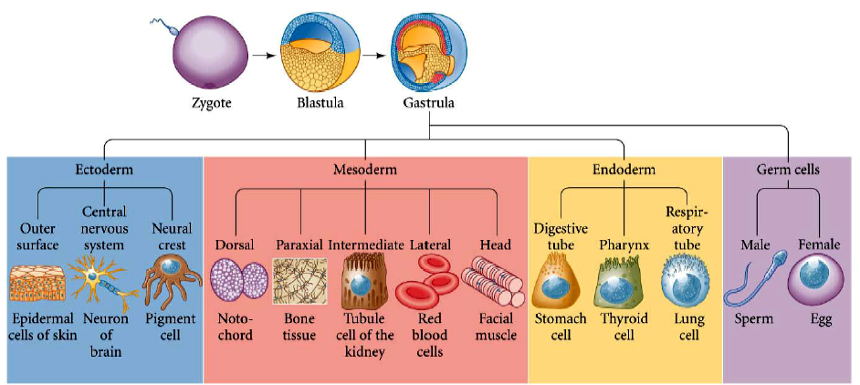
Gene regulation determined the complexities of the eukaryotic organisms

Slide 22
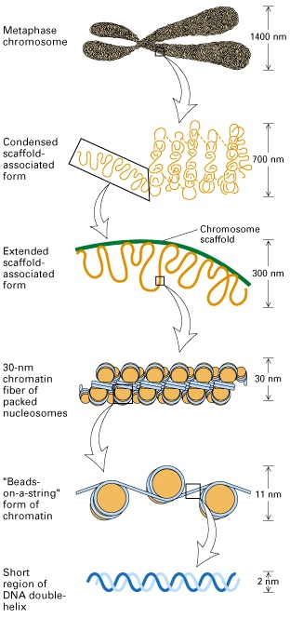
Eukaryotic DNA bind with a variety of protein.
DNA and a group of proteins called ‘histones’ form the primary chromatin structure.
Chromatin in turn complexes with a large array of ‘non-histone’ proteins
chromosome
Increasing complexity of higher order structure
chromatin

Slide 23
Region upstream of the transcription start site in higher eukaryotes
mRNA
GGGCGG
CCAAT
TATA
-200 bp
-100 bp
-30 bp
Promoter proximal elements
Promoter

Slide 24
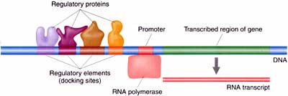
Regulatory elements and promoter of an eukaryotic gene
Regulatory protein
Promoter
Transcribed region of a gene
Promoter
DNA
Regulatory elements
RNA polymerase
RNA transcript
Promoter proximal elements

Slide 25
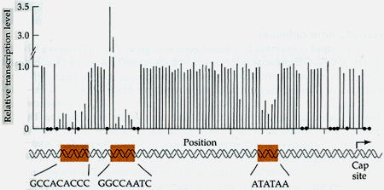
Functional role of the regulatory elements and promoter
Question:
Can changes in the sequence of regulatory sequences too cause gene mutation?
Relative transcription level
The effect of specific point mutations in the proximal regulatory elements and promoter on β-globin gene transcription. Each line represents the transcription level of mutant β-globin gene in a mutant relative to that of its wild-type counterpart. Red arrows shows some the mutations that affect gene transcription. The black dots represent nucleotides for which no mutation had been generated.

Slide 26
Applications of the understanding of the gene regulation

Slide 27
What if lacZ gene is fused with the promoter of another gene?
A different promoter
lacZ

Slide 28
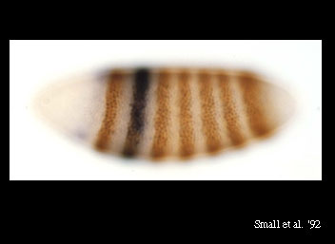
1
2
3
4
5
6
7
Background information
Genes expression is regulated during development – the colored stripes represent the areas where a certain gene (named even-skipped) is expressed . Note a total of total seven stripes

Slide 29

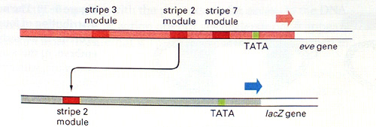
Now a bacterial lacZ gene fused to only stripe 2 module of even skipped regulatory element and injected back into the fly embryo
Normal 7 stripes of even-skipped gene in Drosophila embryo
What does this finding reveal?
Even skipped regulatory region
Stripe 2 module
Regulatory elements of a gene determine its expression in specific locations

Slide 30
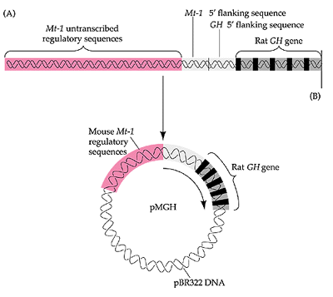
Promoter function seen in transgenic mice.
Recombinant plasmid containing rat growth hormone fused to mouse metallothionein regulatory region in a bacterial plasmid vector
This recombinant plasmid,was injected into the mouse oocytes.
Mt-1 (metallothionein) gene is induced by heavy metal

Slide 31
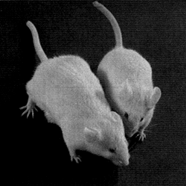
Which one is the mother?
Key conclusions:
Genes regulate functions-
GH → Growth
Promoters drive gene
expression
Promoter of each gene
each gene is uniquely
regulated
A mouse derived from the eggs injected with growth hormone gene (left) and a normal littermate (right).
The expression of a ‘transgene' mostly depends on the regulatory sequences which have been used in the design of the gene construct. A classical example is the transgenic giant mice in which the expression of a growth hormone (GH) gene is driven by the metallothionein promoter

